Slide 1
ARM Processor
- Introduction
Source: inspired by various materials and it is a consolidation! Materials available are plenty, choosing the right one is the toughest task! ☺ Thanks to DR KV Shriram

Slide 2
ARM Processor - Introduction
The first ARM processor was developed at Acorn Computers Limited, of Cambridge,
England, between October 1983 and April 1985. At that time, and until the formation of Advanced RISC Machines Limited (which later was renamed simply ARM Limited) in 1990, ARM stood for Acorn RISC Machine
ARM Cores
Licensed to partners to develop & fabricate new processors and micro-controllers
Soft-core

Slide 3
At the time the first ARM chip was designed, the only examples of RISC architectures were the Berkeley RISC I and II and the Stanford MIPS.
The ARM architecture incorporated a number of features from the Berkeley RISC design, but a number of other features were rejected.
Those that were used were:
• a load-store architecture;
• fixed-length 32-bit instructions;
• 3-address instruction formats.
Those that were Rejected were:
Register Window
Delayed Branches
Single-cycle execution of all instructions.
ARM specializes in the concept of ARM core, which they have licensed to number of other manufacturers to make a variety of chips around the same processor core. (Means, I tell you how to make, you make it in your name!)

Slide 4
ARM Architecture
Features of Basic RISC Architecture
A Large Uniform Register File
Load-Store Architecture, where data processing
operates on register content only
Uniform & fixed length Instructions
32-bit processor
Instructions are 32-bit long
Good Speed/Power Consumption Ratio
High Code Density
The ARM is based on RISC architecture, but it is not a purely RISC architecture because it has been enhanced to meet the requirement of embedded applications. → Versatility!
The requirements for embedded applications are basically high code density, low power consumption as well as low and smaller silicon footprint. Architecturally ARM satisfies various conditions and properties of RISC processors as well.

Slide 5
Principal Enhancements and Features ARM
Control over ALU & Shifter for every data
processing operations to maximize their usage
Auto-Increment & Auto-Decrement Addressing
Modes to optimize program loops
Load & Store Multiple Instructions to maximize
data throughput
Conditional Execution of Instructions to maximize
Execution throughput

Slide 6
ARM Architecture Versions
Version 1 (1983-1985)
26 bit Addressing, no Multiply or Coprocessor
Version 2
Includes 32-bit result multiply coprocessor
Version 3
32-bit Addressing
Version 4
Add Signed , Unsigned Half-word & Signed Byte
Load & Store Instructions
Version 4T
16-bit Thumb - compressed form of Instructions

Slide 7
Architecture Versions
Version 5T
Superset of 4T adding new Instructions
Version 5TE
Add Signal Processing Extension
Examples:
ARM 6 : v3
ARM7 : v3
ARM7TDMI : v4T
StrongArm : v4
ARM 9E-S : v5TE
Home Work ; Explore Cortex A , M and R Series

Slide 8
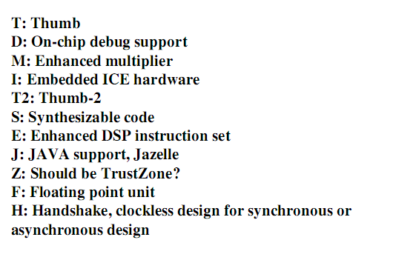
Architecture Versions
Processors based on the ARMv6 architecture include the ARM1136J(F)-S, the ARM1156T2(F)-S, and the ARM1176JZ(F)-S

Slide 9
Overview : Core Data Path
Data Items are placed in Register File
No Data Processing Instructions directly
manipulate Data in memory
Instructions Typically use two Source Registers
& single result or Destination Registers
A Barrel Shifter on the date path can pre-process
data before It enters into ALU
Increment/Decrement Logic can update the
Register Content for Sequential access
independent of ALU

Slide 10
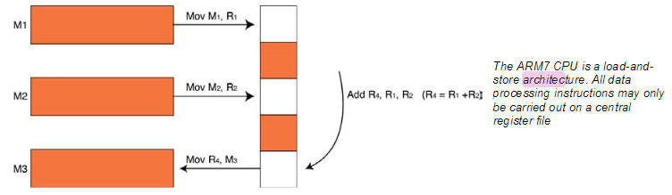
Programmers Model – Register Architecture
The ARM7 is a load-and-store architecture, so in order to perform any data processing instructions the data has first to be moved from the memory store into a central set of registers, the data processing instruction has to be executed and then the data is stored back into memory. (This is Load and Store, Recollect the past)

Slide 11
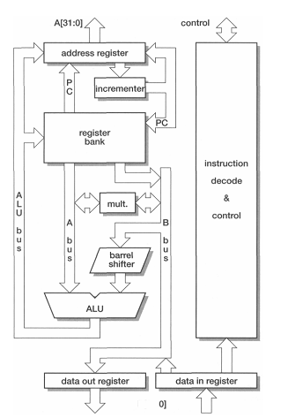
Basic ARM Organization

Slide 12
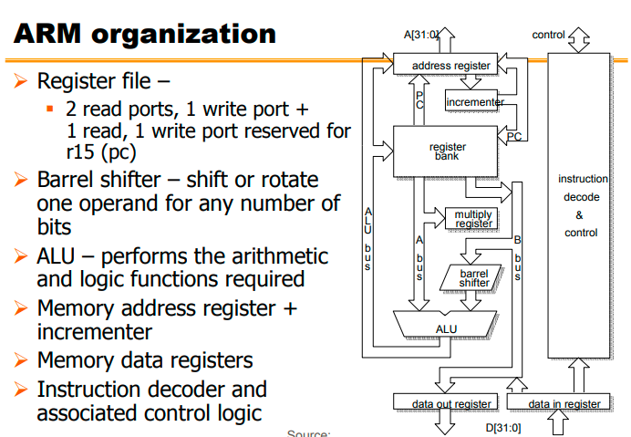

Slide 13
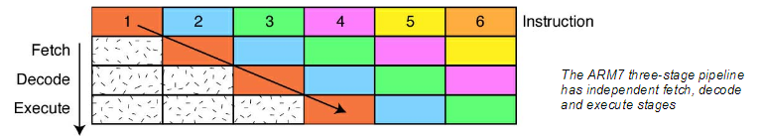
The Pipeline
At the heart of the ARM7 CPU is the instruction pipeline. The pipeline is used to process instructions taken from the program store.
On the ARM 7 a three-stage pipeline is used.

Slide 14
3-stage pipeline ARM organization
Fetch:
The instruction is fetched from memory and placed in the instruction pipeline.
Decode:
The instruction is decoded and the datapath control signals prepared for the next cycle. In this stage the instruction 'owns' the decode logic but not the datapath.
Execute:
The instruction 'owns' the datapath; the register bank is read, an operand shifted, the ALU result generated and written back into a destination register
At any one time, three different instructions may occupy each of these stages, so the hardware in each stage has to be capable of independent operation

Slide 15
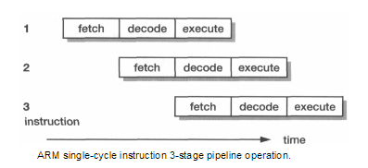
Contd.,
When the processor is executing simple data processing instructions the pipeline enables one instruction to be completed every clock cycle.
An individual instruction takes three clock cycles to complete, so it has a three-cycle latency, but the through-put is one instruction per cycle.

Slide 16
A three-stage pipeline is the simplest form of pipeline and does not suffer from the kind of hazards such as read-before-write seen in pipelines with more stages.
The pipeline has hardware independent stages that execute one instruction while decoding a second and fetching a third.
The pipeline speeds up the throughput of CPU instructions so effectively that most ARM instructions can be executed in a single cycle.
The pipeline works most efficiently on linear code. As soon as a branch is encountered, the pipeline is flushed and must be refilled before full execution speed can be resumed.
As we shall see, the ARM instruction set has some interesting features which help smooth out small jumps in your code in order to get the best flow of code through the pipeline.
As the pipeline is part of the CPU, the programmer does not have any exposure to it.
Notes:
A barrel shifter is a digital circuit that can shift a data word by a specified number of bits without the use of any sequential logic, only pure combinatorial logic. ... A barrel shifter is often used to shift and rotate n-bits in modern microprocessors, typically within a single clock cycle.

Slide 17
Conditional Execution – Remember this.
Most instruction sets only allow branches to be executed conditionally.
However by reusing the condition evaluation hardware, ARM effectively increases number of instructions.
All instructions contain a condition field which determines whether the CPU will execute them.
Non-executed instructions soak up 1 cycle.
Still have to complete cycle so as to allow fetching and decoding of following instructions.
This removes the need for many branches, which stall the pipeline (3 cycles to refill).
Allows very dense in-line code, without branches.
The Time penalty of not executing several conditional instructions is frequently less than overhead of the branch or subroutine call that would otherwise be needed.

Slide 18
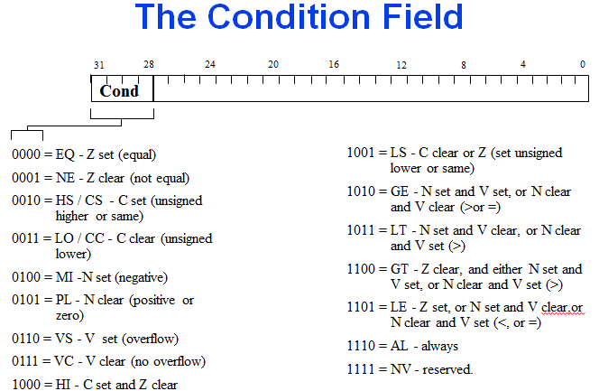
Condition Field.

Slide 19
Conditional Execution
To execute an instruction conditionally, simply postfix it with the appropriate condition:
For example an add instruction takes the form:
ADD r0,r1,r2 ; r0 = r1 + r2 (ADDAL)
To execute this only if the zero flag is set:
ADDEQ r0,r1,r2 ; If zero flag set then… ; ... r0 = r1 + r2
By default, data processing operations do not affect the condition flags (apart from the comparisons where this is the only effect). To cause the condition flags to be updated, the S bit of the instruction needs to be set by postfixing the instruction (and any condition code) with an “S”.
For example to add two numbers and set the condition flags:
ADDS r0,r1,r2 ; r0 = r1 + r2 ; ... and set flags

Slide 20
5 stage pipeline
Higher performance ARM cores employ a 5-stage pipeline and have separate instruction and data memories.
Breaking instruction execution down into five components rather than three reduces the maximum work which must be completed in a clock cycle, and hence allows a higher clock frequency to be used (provided that other system components, and particularly the instruction memory, are also redesigned to operate at this higher clock rate).

Slide 21
Contd.,
Fetch: the instruction is fetched from memory and placed in the instruction pipeline.
Decode: the instruction is decoded and register operands read from the register file. There are three operand read ports in the register file, so most ARM instructions can source all their operands in one cycle.
Execute: an operand is shifted and the ALU result generated. If the instruction is a load or store the memory address is computed in the ALU.
Buffer/data: data memory is accessed if required. Otherwise the ALU result is simply buffered for one clock cycle to give the same pipeline flow for all instructions.
Write-back: the results generated by the instruction are written back to the register file, including any data loaded from memory.

Slide 22
ARM Registers including CPSR
Refer 3.ARM-Registers Presentation

Slide 23
ARM Processor Modes
Refer 4.ARM-Operating Modes Presentation

Slide 24
ARM Core Data Flow Model
Refer 5.ARM-Data Flow Model Presentation

Slide 25
Memory

Slide 26
The ARM7TDMI processor views memory as a linear collection of bytes numbered in ascending order from zero. For example:
bytes zero to three hold the first stored word
bytes four to seven hold the second stored word.
The ARM7TDMI processor is bi-endian and can treat words in memory as being stored in either:
Little-endian. traditionally the default format for ARM processors.
Big-endian
Endian configuration has no relevance unless data is stored as words and then accessed in smaller sized quantities (halfwords or bytes).

Slide 27
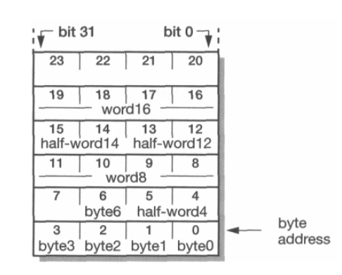

Slide 28
In addition to the processor register state, an ARM system has memory state.
Memory may be viewed as a linear array of bytes numbered from zero up to (2 to the power 32 ) minus 1.
Data items may be 8-bit bytes, 16-bit half-words or 32-bit words.
Words are always aligned on 4-byte boundaries (that is, the two least significant address bits are zero) and half-words are aligned on even byte boundaries.
This shows a small area of memory where each byte location has a unique number.
A byte may occupy any of these locations.
Half-words occupy two byte locations starting at an even byte address.
A word-sized data item must occupy a group of four byte locations starting at a byte address which is a multiple of four.

Slide 29
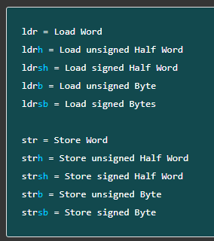


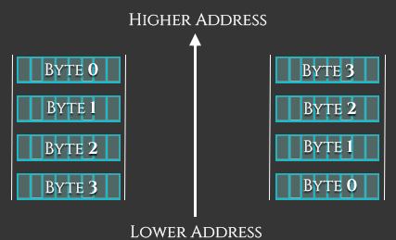
The extensions for these data types are: -h or -sh for halfwords, -b or -sb for bytes, and no extension for words.
The difference between signed and unsigned data types is:
Signed data types can hold both positive and negative values and are therefore lower in range. The range of 2’s complement form is from minus (2^{(n-1)}) to 0 to plus (2^{(n-1)}-1).
Unsigned data types can hold large positive values (including ‘Zero’) but cannot hold negative values and are therefore wider in range. 0 to (2^{n}-1)
Endian – Big or Little ???

Slide 30
Home Work

Slide 31
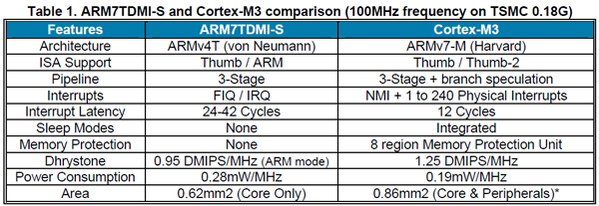

Slide 32
References
https://www.electronicshub.org/arm-introduction/
https://developer.arm.com/documentation/ddi0210/c/Programmer-s-Model/Registers/The-ARM-state-register-set?lang=en
https://developer.arm.com/architectures/cpu-architecture/a-profile
https://www.arm.com/product-filter?families=cortex-a
https://www.arm.com/product-filter?families=cortex-r
https://www.arm.com/product-filter?families=cortex-m

Slide 33
Queries ?

